Slide 1
Agency Prepayment V2.10
July 2016

Slide 2
Three Problems to Address in V2.1
1
The model is too fast after 2014
Model tracking for the post-2014 period is much faster than actual
The problem is potentially caused by the fact that 2-year HPA is not a good proxy for Mortgage Credit Availability. In particular, other indicators of MCA suggest that this metric was relatively unchanged post-2014 as opposed to the significant pickup in 2-year HPA over this period.
We need to locate a better proxy for tracking changes in MCA.
2
The model shows too little sensitivity with respect to loan size
Refinancing sensitivity is too low for loan sizes in the 50K-300K range
Improved multiplier for loan size. A future iteration will also take “elbow” effects into consideration
3
The model is too slow for high LTV loans
Tracking for CR pools is too slow
One potential suspect is turnover projections for CRs (as most of the CR pools are out-of-the-money, their speeds are largely determined by turnover model)
Revisit turnover model parameters for High LTV loans

Slide 3

Model Update Overview 1. Credit Availability Update
To select an alternative proxy for MCA, we compared four other candidates
Refi Module
Horse Race Framework
S-Curve
11 Parameters
3 Parameters
Automatic Curve Optimization
S Curve
Media Effect
Credit Availability
WALA
Burnout
Loan size
CLTV(Normal / HARP)
HARP-Eligible
Refi-Elig %
HARPed %
TPO %
S Curve
Media Effect
Generalised logistic function
Fixed
$$Y\left(t\right)=A+\frac{K−A}{{(C+Qe^{−B(t−M)})}^{1/ν}}$$
MCA Indicators
HPA2Yr
MBA MCAI
MBA Purchase Index
Cello MCAI
A: the lower asymptote
K: the upper asymptote.
B : the growth rate
nu: affects near which asymptote maximum growth occurs
Q : is related to the value Y(0)
Don’t use in the Horse Race
Optimization – Least Square
Compare Tracking Root Mean Squared Error (RMSE)

Slide 4
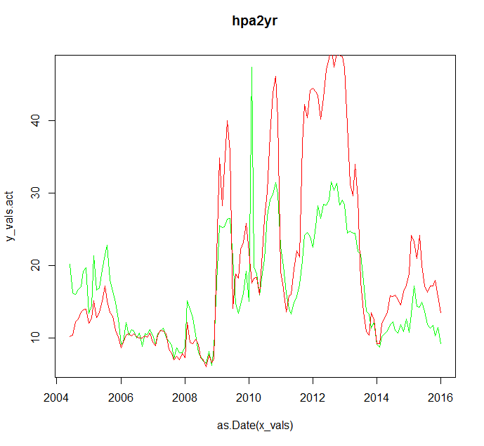
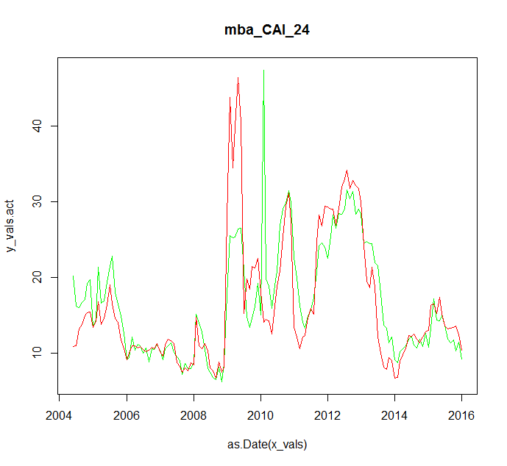
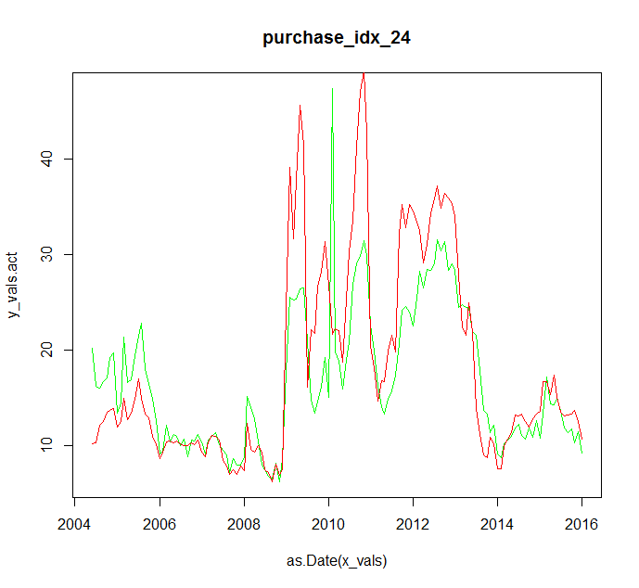
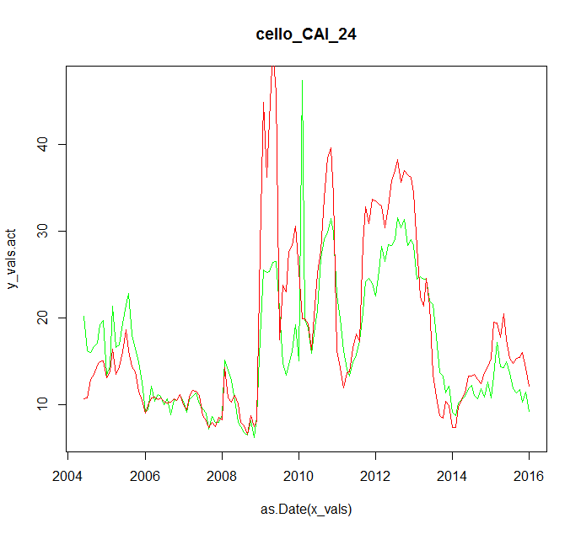
Model Update Overview 1. Credit Availability Update
RMSE = 7.9710e-2
RMSE = 7.7610e-2
RMSE = 7.8410e-2
RMSE = 7.8410e-2
Using the four candidate MCA indicators, we tested the tracking from 2004 to 2016. The total RMSE shows the three new curves have better fits compared with the HPA-2yr index. The MBA CAI has the best performance among the four.

Slide 5
Model Update Overview 1. Credit Availability Update
 | mba_CAI | purchase_idx | cello_CAI
24 Month | 0.0775741 | 0.0784130 | 0.0783926
18 Month | 0.0770801 | 0.0787880 | 0.0777685
12 Month | 0.0791511 | 0.0791555 | 0.0862411
6 Month | 0.0783332 | 0.0807010 | 0.1008529
From the RMSE numbers showed above, the best combination is MBA MCAI with an 18 month moving average.
All three potential replacements demonstrate reasonable tracking performance when either an 18- or 24-month moving average is used. Performance degrades when shorter (6- or 12-month) time periods are chosen.

Slide 6
Model Update Overview 1. Credit Availability Update
As the MBA CAI data is only available after 2004, we need to backfill the data set. Since the next best candidate for the MCA Index is the Purchase Index and there is a significant amount of historical data available on the Purchase Index, we will use trends in the Purchase Application data to backfill the MCAI.
We regress MBA Purchase Applications data against the MBA MCAI from 2005 to 2016 and use the model to backfill history going back to 1994.

Slide 7
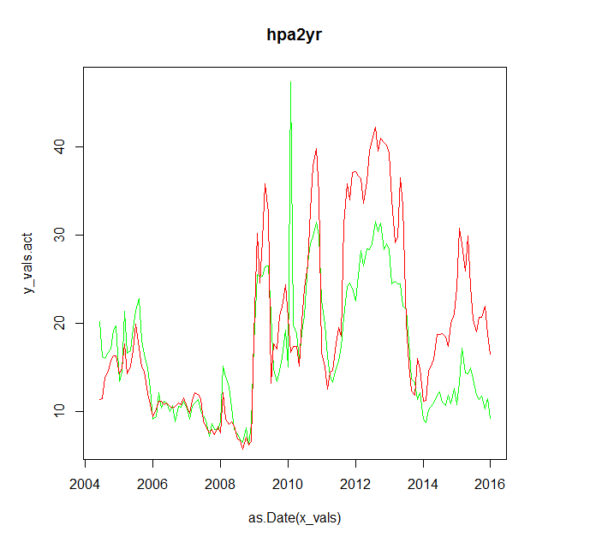
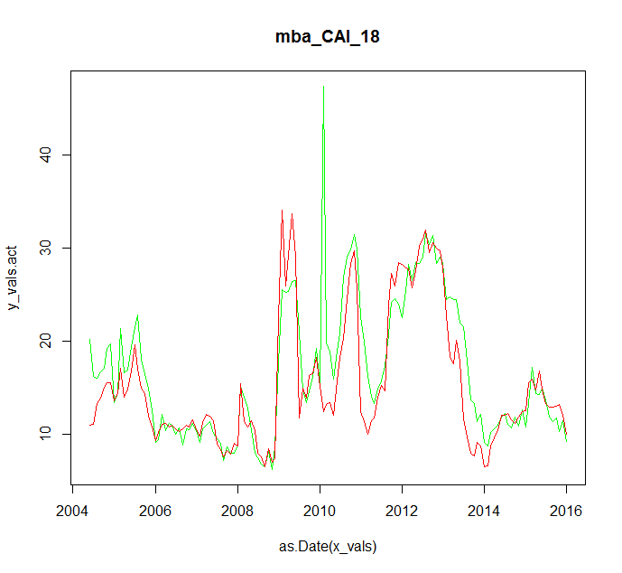
Model Update Overview 1. Credit Availability Update
Tracking Result Using Current HPA2Yr Model
Tracking Result Using MBA MCAI 18 Month
From the charts, we can clearly see a significant improvement in the model fits. In particular, the issue that the model is tracking too fast after 2014 should be addressed.

Slide 8
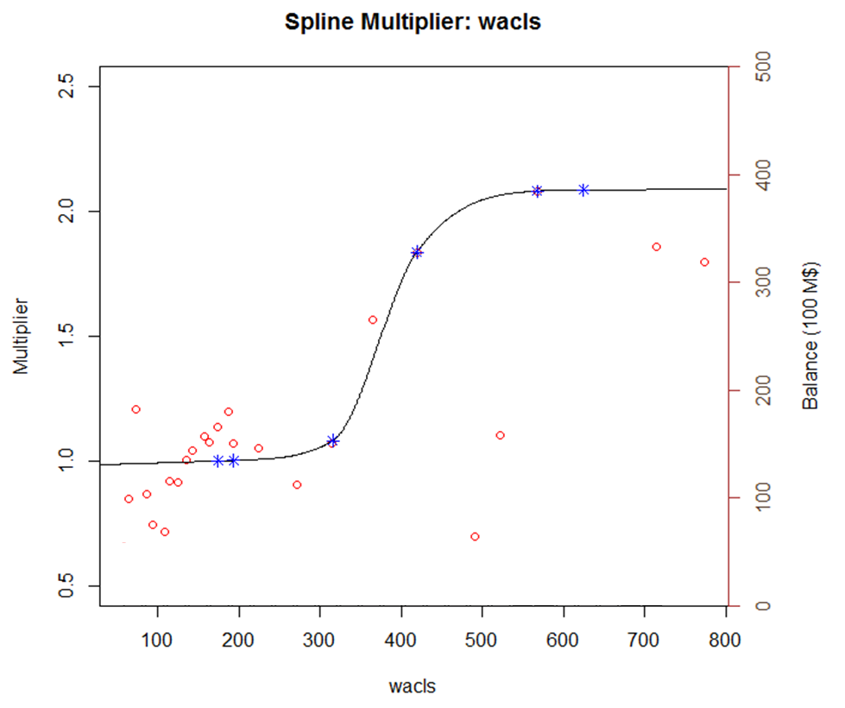
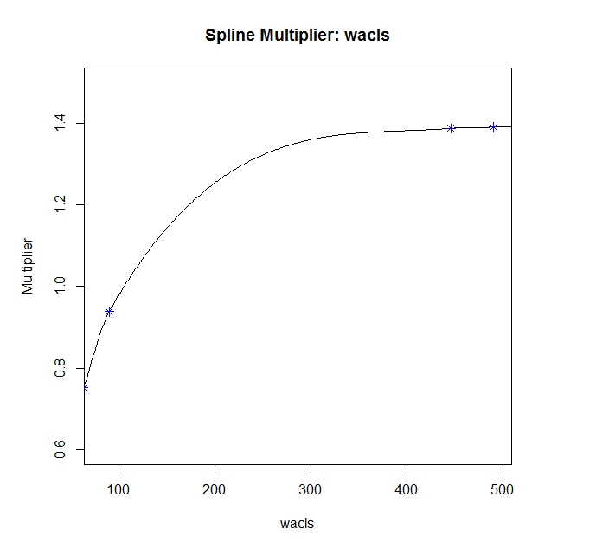
Model Update Overview 2. Loan Size
Loan Size Curve in V2.00
Loan Size Curve in V2.10
In v2.1, we decided to focus on the range between 0-300K, where most of the data falls in. Patching up the curve here should address a significant portion of the sensitivity issues.

Slide 9
Model Update Overview 3. High CLTV
In v2.0, the model tracking for high CLTV pools is too slow..
The improvement focused on the higher end of CLTV curve.

Slide 10
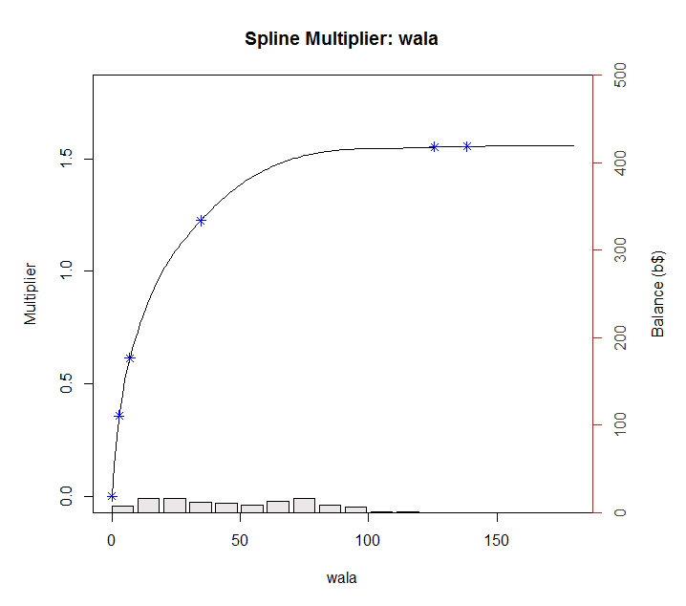
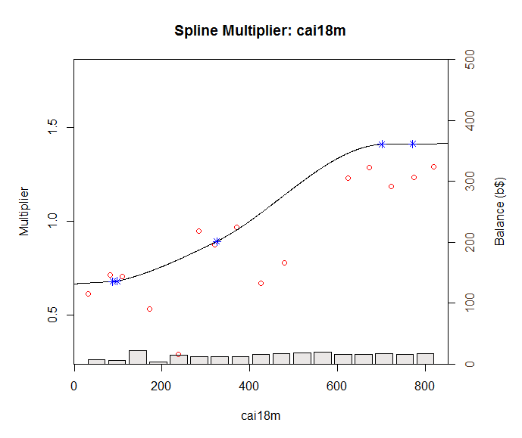
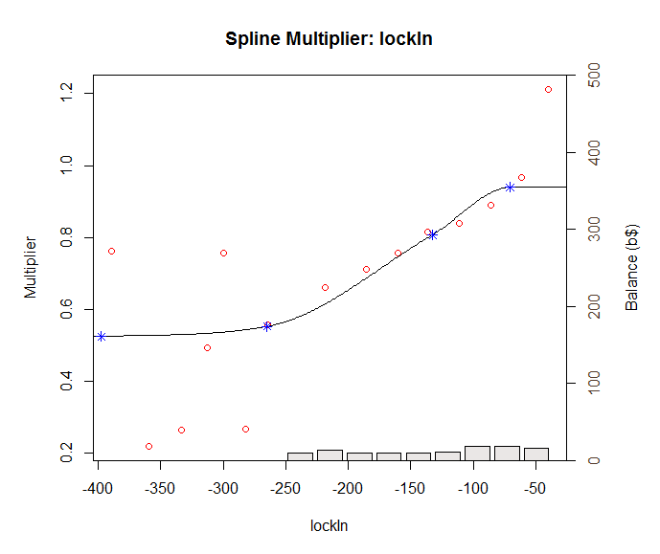
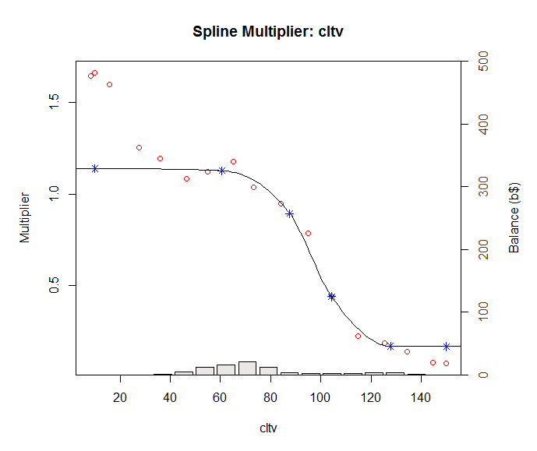
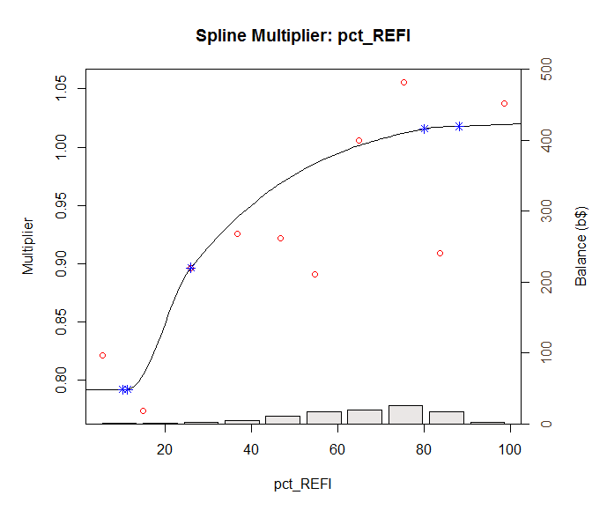
Model Update Overview 4.Turnover
As the credit availability parameter is the second in the sequential fitting process. After fitting it, we need to rebuild all other curves after it.
WALA is not affected by the update.

Slide 11
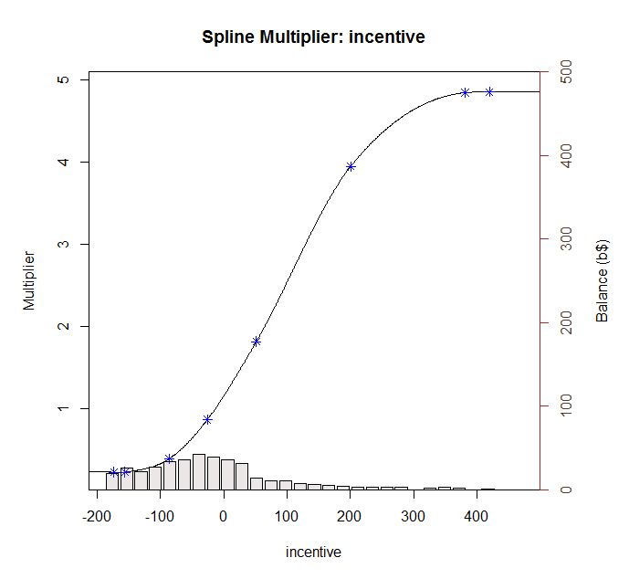
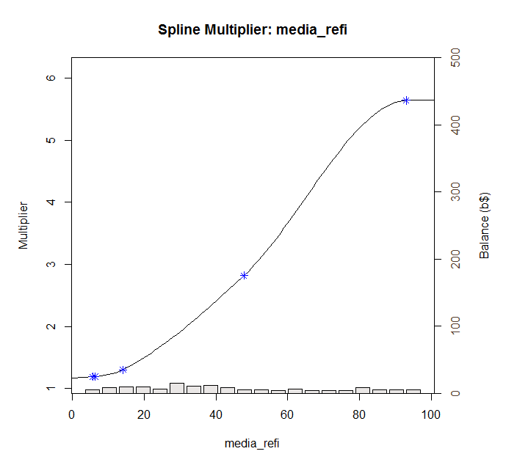
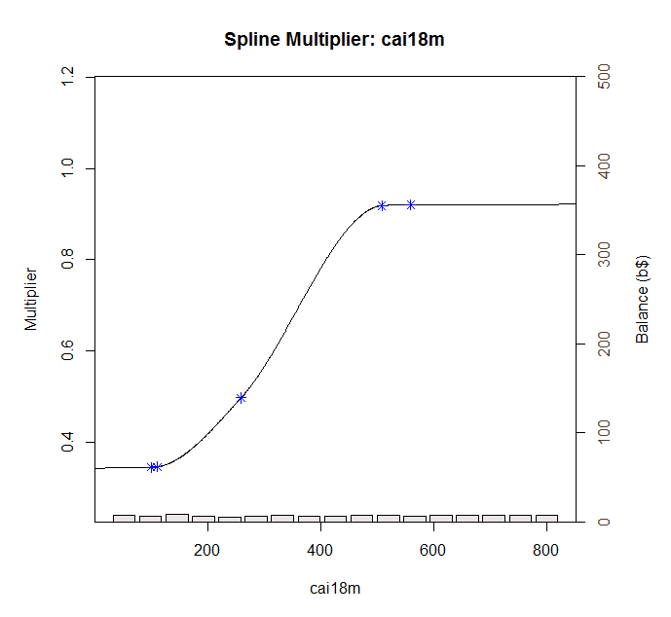
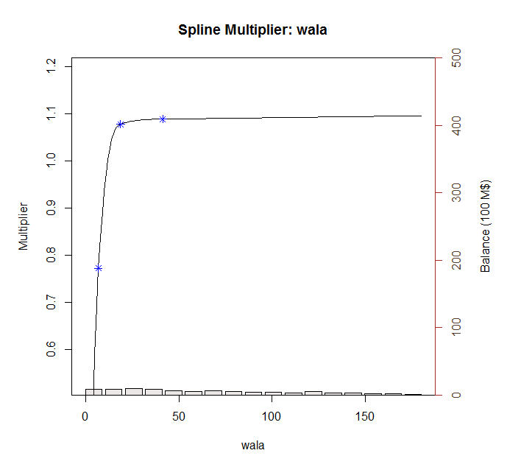
Model Update Overview 5.Refinance
Similar to the Turnover submodel, the credit availability parameter is the third in the sequential fitting process. After fitting it, we need to rebuild all other curves after it. And due to the Turnover model update, the baseline S-curve also needs to be updated.

Slide 12
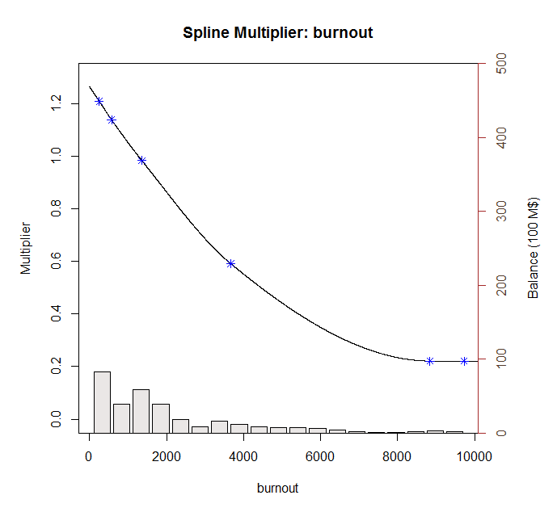
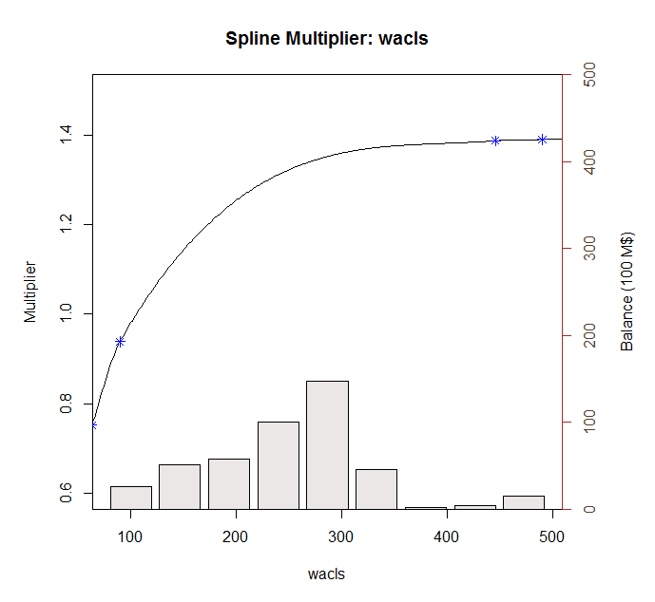
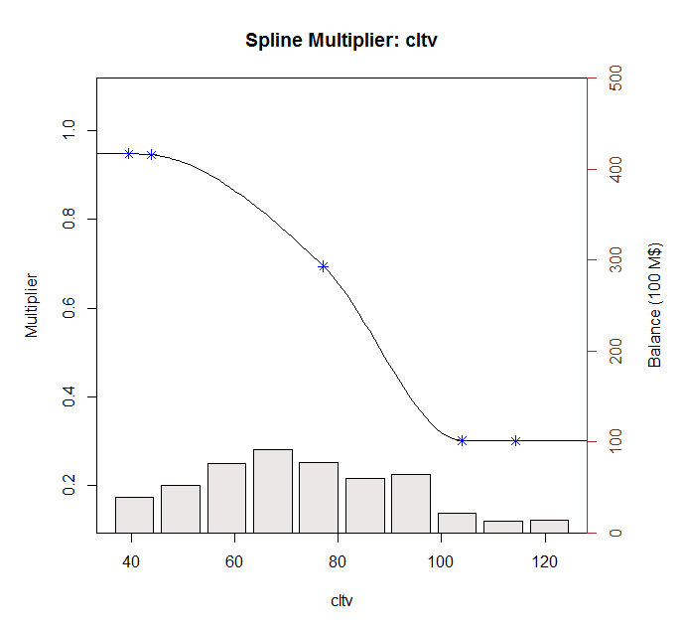
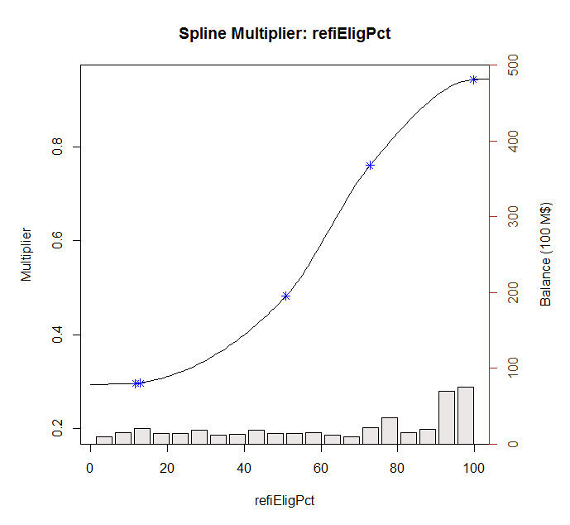
Model Update Overview 5.Refinance

Slide 13
Model Update Overview 6. Overall Tracking Results

